Slide 1
FM Synthesis

Slide 2
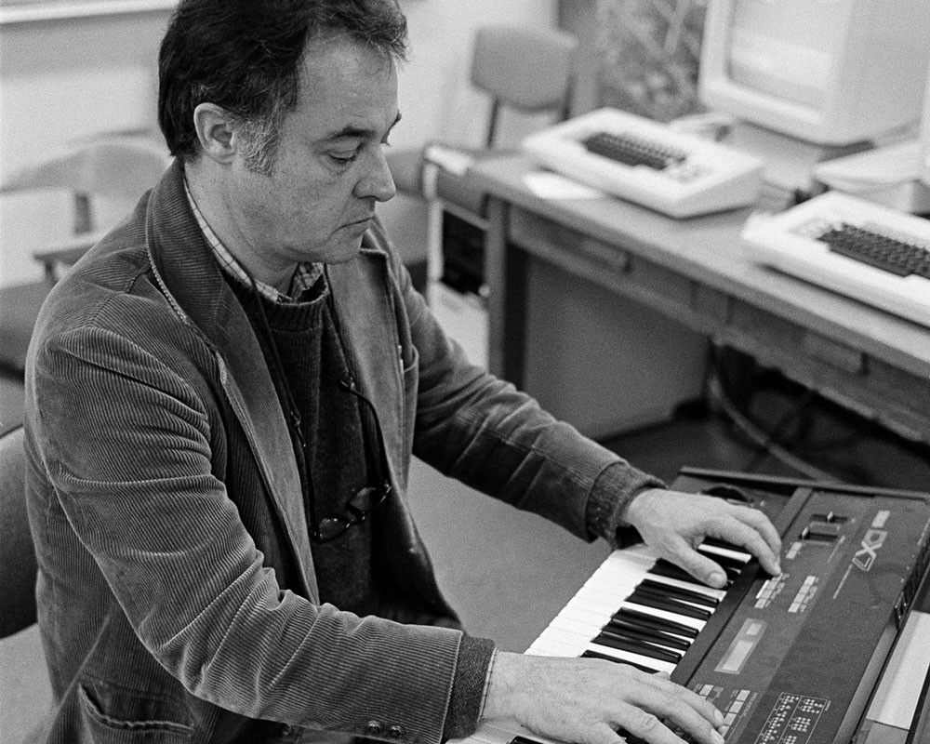
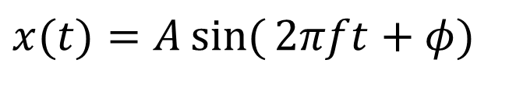
FM synthesis
Modulation - varying properties of periodic waveform, carrier signal, with modulating signal
FM synthesis - Creating sound by modulating waveform’s frequency using another waveform
Chowning, John M. "The synthesis of complex audio spectra by means of frequency modulation." Journal of the audio engineering society 21.7 (1973): 526-534.
Vary A – Amplitude modulation
Vary f – Frequency modulation
Vary φ – Phase modulation
$$x(t)=A\sin{(}2πft+φ)$$

Slide 3


Frequency modulation synthesis
$$x(t)=\sin{(}2πf_{c}t)$$
Simple sine wave
x(t) – the carrier
f _{c} – carrier frequency, gives fundamental frequency
Now modulate the frequency
f (t) – the modulator
f _{m} –modulation frequency
D – modulation depth
Chowning originally did
phase modulation
$$f(t)=D\sin{(}2πf_{m}t) \\ →x(t)=\sin{(}2π(f_{c}+f\left(t\right))t) \\ =\sin{(}2π(f_{c}+D\sin{(}2πf_{m}t))t)$$
$$f(t)=D\sin{(}2πf_{m}t) \\ →x(t)=\sin{(}2π{(f}_{c}t+f(t))) \\ =\sin{(}2π(f_{c}t+D\sin{(}2πf_{m}t)))$$
Notes:
See https://www.eeeguide.com/theory-of-frequency-modulation-and-phase-modulation/
http://www.cs.cmu.edu/~music/icm-online/readings/fm-synthesis/fm_synthesis.pdf

Slide 4
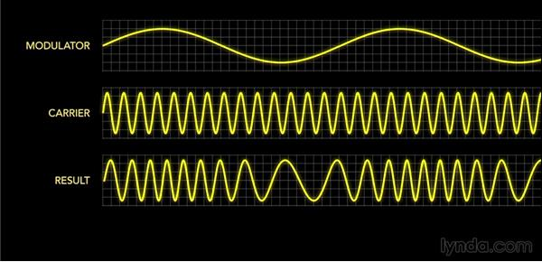
Example

Slide 5
Define and initialise
Set this up as a JUCE Standalone plugin
Add private parameters to pluginProcessor.h
Add audio parameters & adjust their ranges in pluginProcessor.cpp
juce::AudioParameterFloat* modulationDepthParam;
juce::AudioParameterFloat* modulatorFrequencyParam;
juce::AudioParameterFloat* carrierFrequencyParam;
float modulatorPhase = 0; // Phase of modulator, range 0 to 1
float modulatedCarrierPhase = 0; // Phase of carrier, with modulation, range 0 to 1
float modulatorSignal;
float modulatedCarrierSignal;
addParameter(modulationDepthParam = new juce::AudioParameterFloat
("modulationDepth", "Modulation depth", 0.0f, 1000.0f, 200.0f));
addParameter(modulatorFrequencyParam = new juce::AudioParameterFloat
("modulatorFrequency", "Modulator frequency", 10.0f, 200.0f, 100.0f));
addParameter(carrierFrequencyParam = new juce::AudioParameterFloat
("carrierFrequency", "Carrier frequency", 50.0f, 2000.0f, 800.0f));
Notes:
MidiKeyboardComponent needs a MidiKeyboardState and the orientation as arguments.

Slide 6
The ProcessBlock
Nothing needed in PrepareToPlay
Set up the basics in the processBlock method on pluginProcessor.cpp
…
auto numInputChannels = getTotalNumInputChannels();
auto numOutputChannels = getTotalNumOutputChannels();
float sampleRate = (float) juce::AudioProcessor::getSampleRate();
float modulationDepth = modulationDepthParam->get();
float modulatorFrequency = modulatorFrequencyParam->get();
float carrierFrequency = carrierFrequencyParam->get();
…
Notes:
/ Having made a local copy of the state variables for each channel, now transfer the result
// back to the main state variable so they will be preserved for the next call of processBlock()

Slide 7
The ProcessBlock
Finally, generate output samples using FM synthesis
for (int i = 0; i < buffer.getNumSamples(); ++i) {
modulatorSignal =
modulationDepth * sinf(juce::MathConstants<float>::twoPi * modulatorPhase);
modulatedCarrierSignal =
sinf(juce::MathConstants<float>::twoPi * modulatedCarrierPhase);
for (int j = 0; j < numOutputChannels; ++j)
buffer.getWritePointer(j)[i] = modulatedCarrierSignal;
modulatorPhase += modulatorFrequency / sampleRate;
while (modulatorPhase >= 1.0) modulatorPhase -= 1.0;
modulatedCarrierPhase += (carrierFrequency + modulatorSignal) / sampleRate;
while (modulatedCarrierPhase >= 1.0) modulatedCarrierPhase -= 1.0;
}
Notes:
/ Having made a local copy of the state variables for each channel, now transfer the result
// back to the main state variable so they will be preserved for the next call of processBlock()

